Slide 1
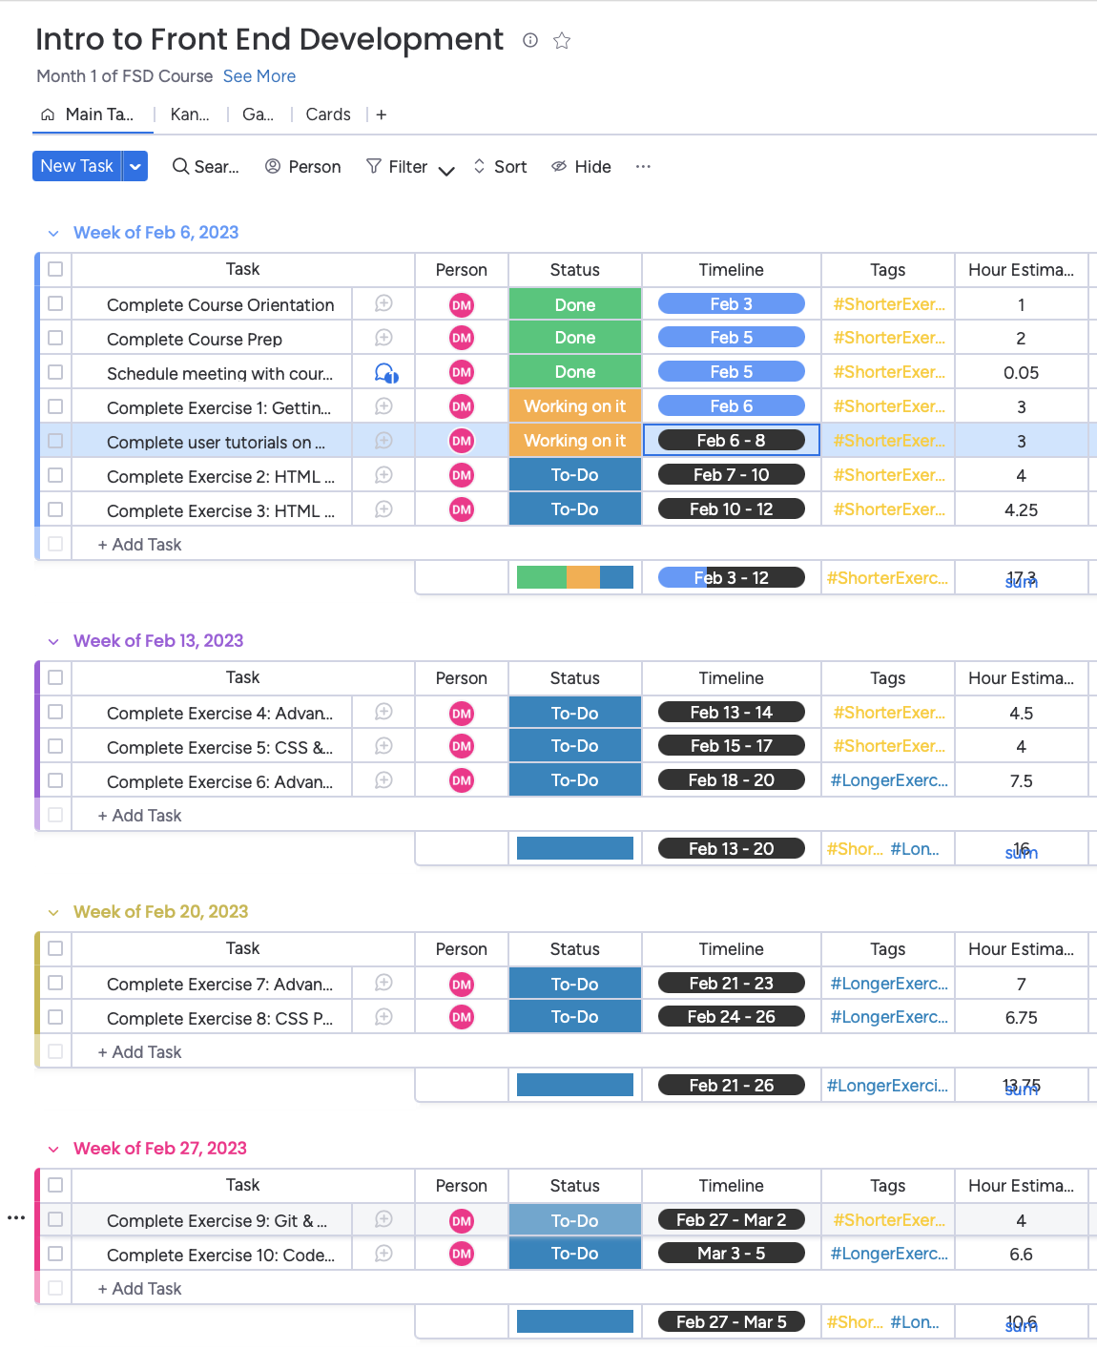
Table View, albeit a bit difficult to read when shrunk down like this.

Slide 2
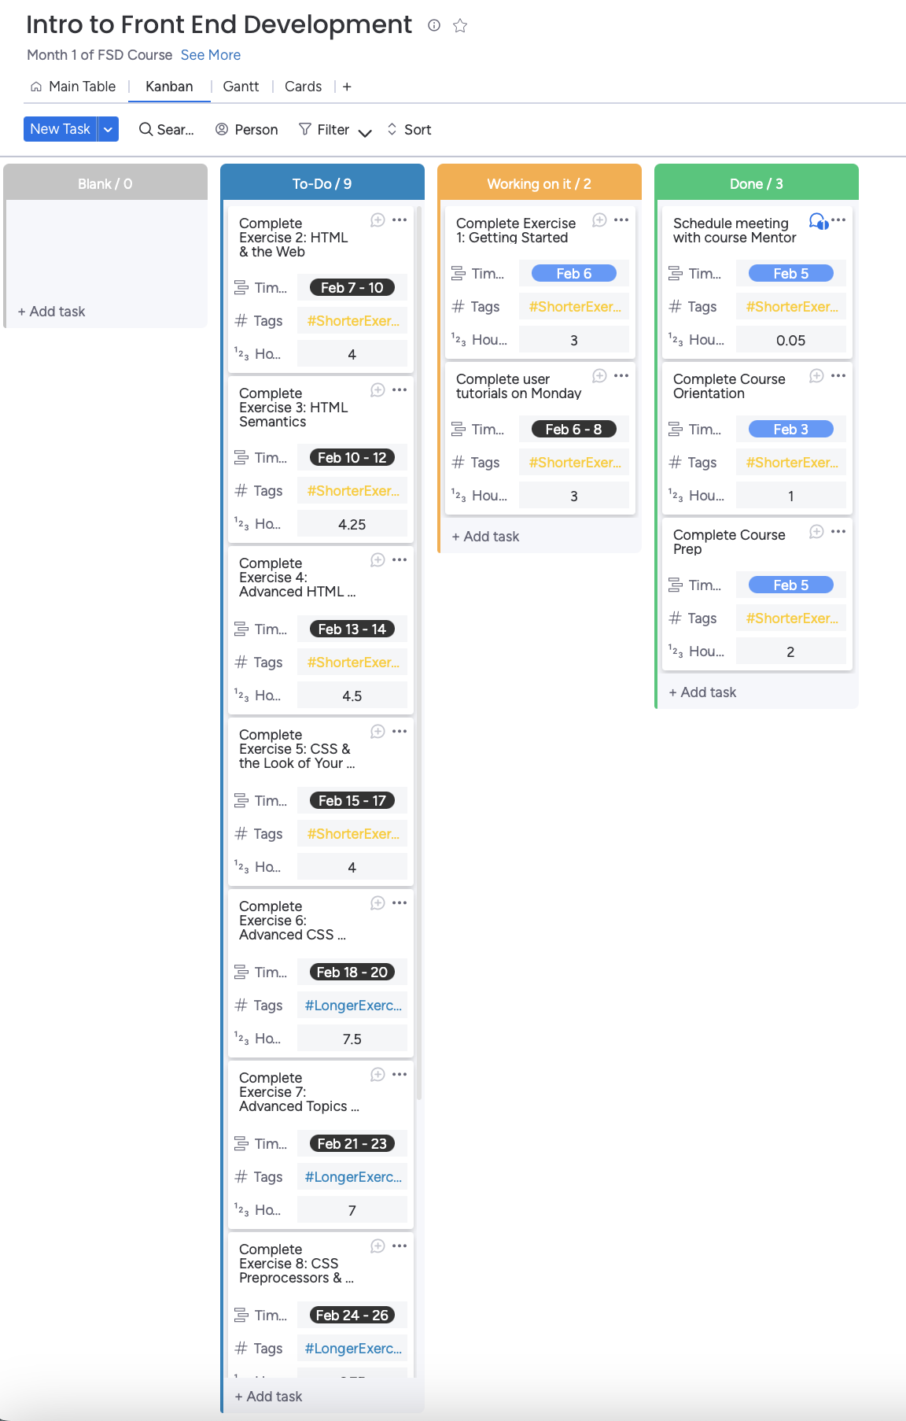
Kanban View, albeit a bit difficult to read when shrunk down like this, and despite shrinking my screen down as much as possible, I couldn’t fit in all of the ”to-do” items.

